Slide 1

Smart Home System
B1-4
ESIoT Lab Mini Project Presentation 2022-23
Team Members:
Shubham Sarkar
Akash Mohapatra
Chaitanya Dumbre
Neha Mendhekar
Guided By:
Seema Patil
Dhananjay Bhagat

Slide 2
Content
Introduction and Motivation
Problem Statement and Objectives
Individual Contribution
Summary of Literature Survey
Proposed System
Hardware and Software Requirements
Implementation and Experimental Setup
Results and Conclusions
References

Slide 3
Introduction and Motivation
Home automation has evolved significantly in recent years, providing convenience, energy efficiency, and enhanced security. This project aims to develop a smart home system that integrates voice and gesture commands with face recognition to control home appliances like lights and fans, ensuring only authorized users can access the system. Wireless IoT communication is employed for seamless control of appliances, making the system both practical and secure.

Slide 4
Problem Statement and Objectives
Traditional smart home systems either focus on convenience or security, but often lack the ability to combine both. This project addresses that gap by incorporating face recognition for security alongside voice and gesture commands for ease of use. The system ensures that only authorized individuals can control the appliances and uses wireless IoT communication to trigger devices such as lights and fans.
Objectives:
Develop a system that can detect and process voice and gesture commands.
Ensure wireless communication for reliable control of household appliances.
Implement access control using face recognition to prevent unauthorized use.

Slide 5
Individual Contribution
Name | Work (Report/Presentation/Algorithm Design/Implementation)
Shubham Sarkar | Flow Planning + Hardware Implementation + Command bias in STT
Akash Mohapatra | Face Recognition and Text to Speech + Hardware Implementation
Chaitanya Dumbre | Gesture recognition + Hardware Implementation
Neha Mendhekar | ESP code

Slide 6
Summary of Literature Survey
Paper Ref. (as per order of references) | Title of Paper | Method Used | How is it useful for your project
Siamese Network | Face Recognition using Siamese Network | Finds face embeddings and does the face matching | Uses less dataset to train the model giving better results
ESP8266 in IoT System | Design of Home Appliance Control System in Smart Home based on WiFi IoT | ESP8266 enabled remote WiFi control. | Hardware Integration

Slide 7
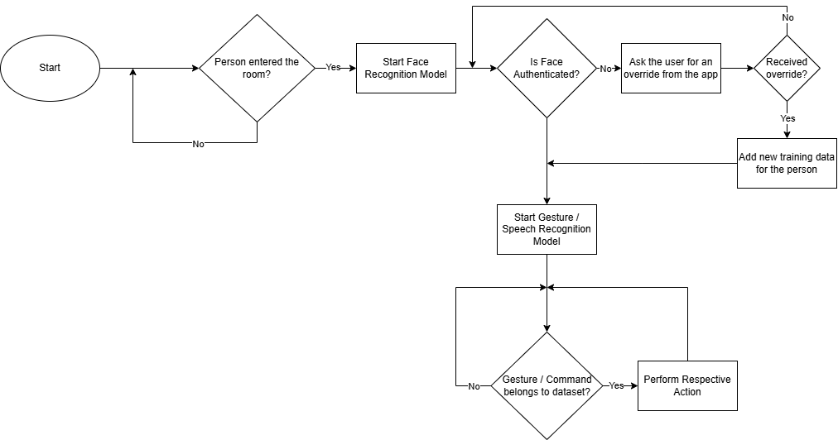
Proposed System

Slide 8
Proposed System
Person Detection: PIR Motion Sensor will be used to detect entry and exit of a room
Face Recognition: Use Siamese Networks to compare extracted features from face to features of faces stored in the model weights.
Gesture Recognition: Each action (turn on/off led) or (increase/decrease fan speed) has its own gesture.
Speech Recognition: Using Realtime STT, speech recognition is performed for voice commands
Actuation:
After the ESP receives an API request, it performs the respective action.
For fans, a float value is received indicating the direction and velocity, while for lights, a binary setting is passed.

Slide 9
Hardware and Software Requirements
Hardware | Model | Justification w.r.t project
ESP Board | 8266 | Performs actuation after receiving api calls
PC | i7-12650H, RTX3050Ti and 32GB ram | Runs the models
Raspberry Pi / ESP Cam | Raspberry Pi 2 Model B | Acts as the smart device which communicates with pc and esp wirelessly
Software | Justification w.r.t project
Python Env | Has all necessary libraries to run all the models
Arduino IDE | Used to program the ESP 8266 with wifi server and actuation

Slide 10
Implementation and Experimental Setup
In our current implementation, the speech, hand gestures and facial recognition models run locally on our laptop and use the laptop’s peripherals to get user input.
Once a suitable action is decided, an api call is made to the esp connected to the same WiFi, and its actuators are triggered.
We plan to replace the laptop with a Raspberry Pi if possible.

Slide 11
Results and Conclusion
Preliminary tests show that the system accurately recognizes authorized users within a certain range and responds to both voice and gesture commands with minimal latency. The wireless communication reliably triggers appliances, and the face recognition module effectively prevents unauthorized access. This system combines security and convenience, offering a smart home solution that is both user-friendly and secure.

Slide 12
References
Realtime STT
Face recognition based on convolution siamese networks | IEEE Conference Publication | IEEE Xplore
Using Siamese Networks with Transfer Learning for Face Recognition on Small-Samples Datasets | IEEE Conference Publication | IEEE Xplore
Real-time human gesture grading based on OpenPose
Design of Home Appliance Control System in Smart Home based on WiFi IoT| IEEE Conference Publication |IEEE Xplore
Sign Language Gesture Recognition with Convolutional-Type Features on Ensemble Classifiers and Hybrid Artificial Neural Network
Dynamic Gesture Recognition Based on LSTM-CNN

